Slide 1
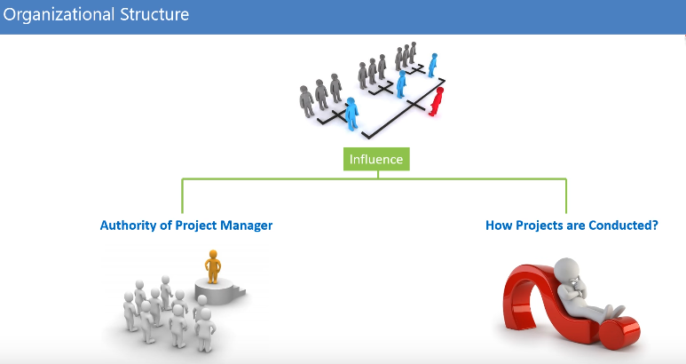

Slide 2
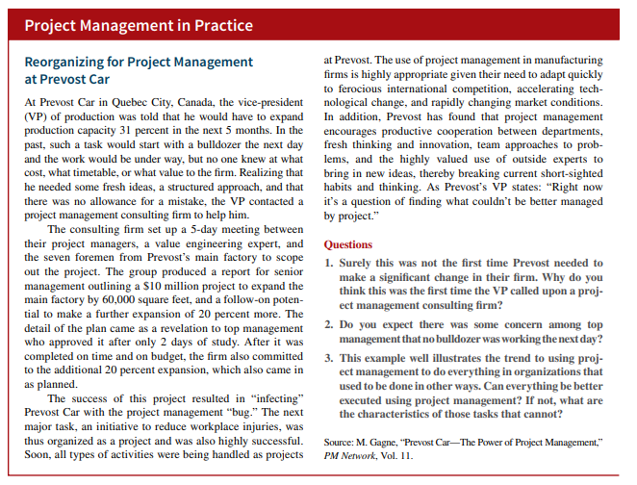

Slide 3
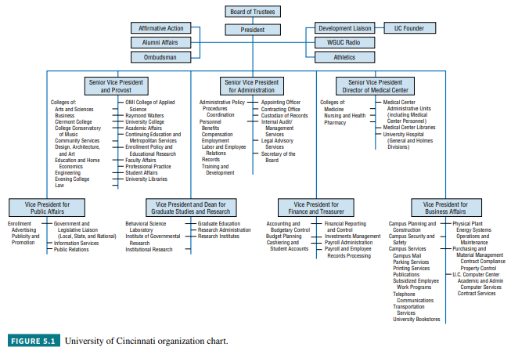

Slide 4
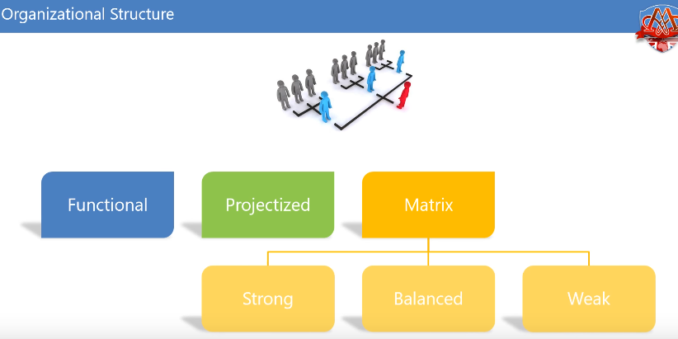

Slide 5
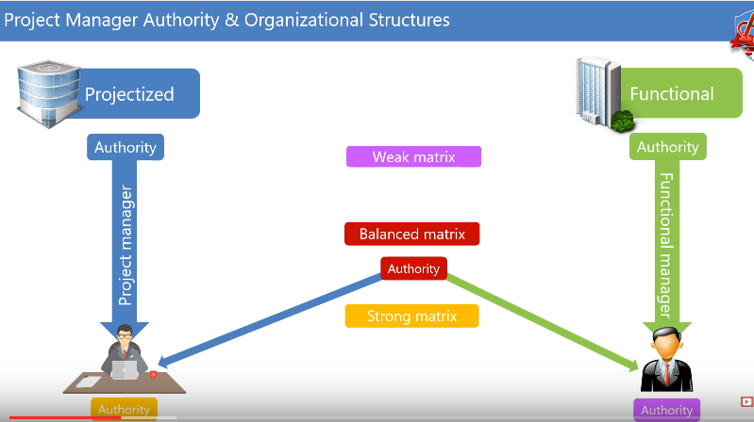

Slide 6
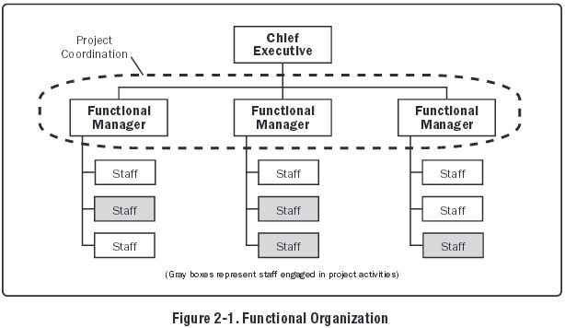

Slide 7
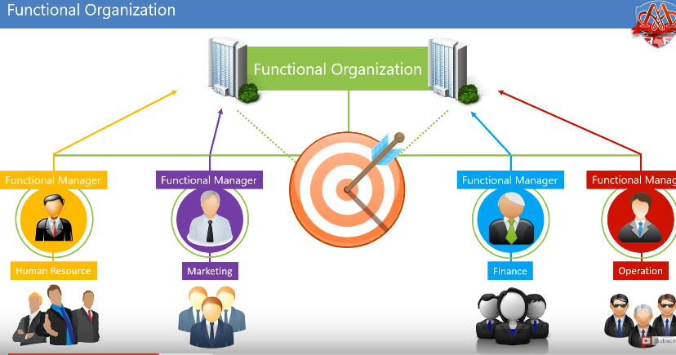

Slide 8
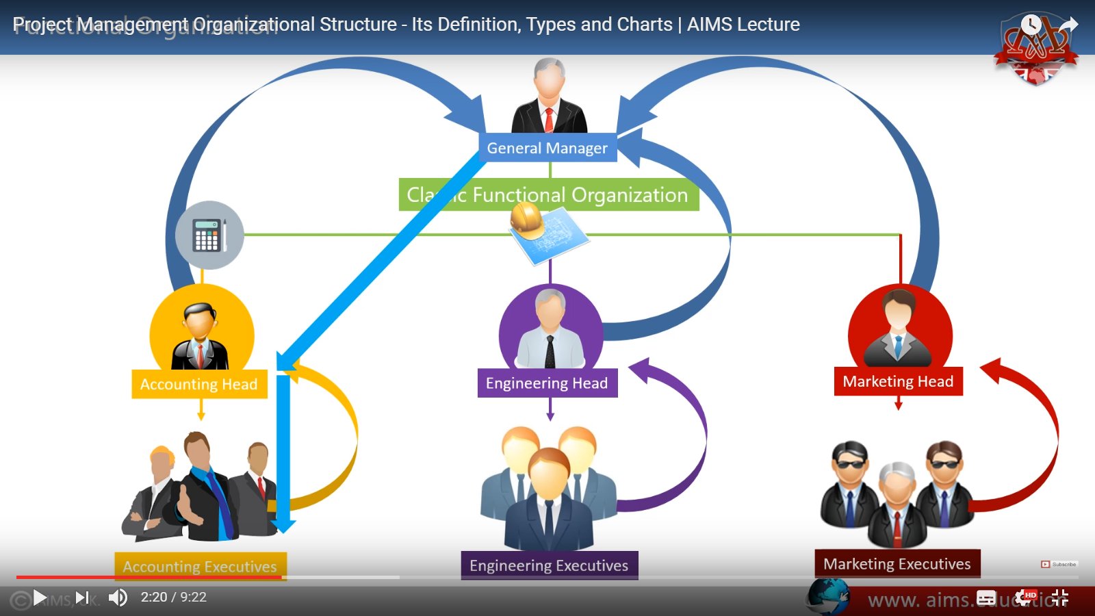

Slide 9
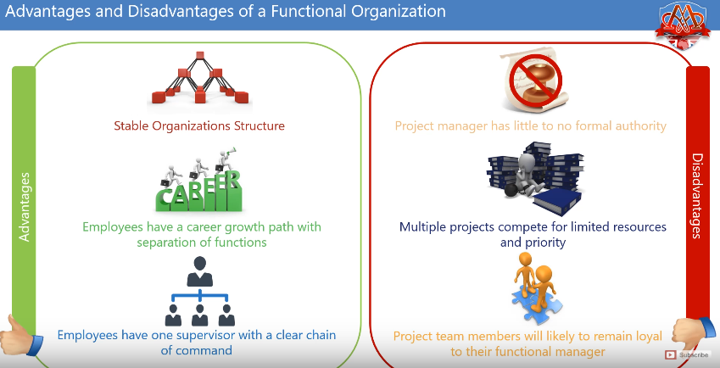

Slide 10
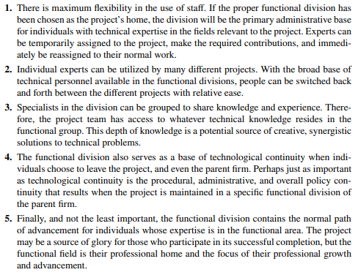
Advantages

Slide 11
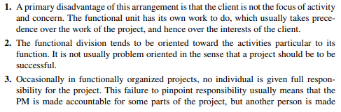
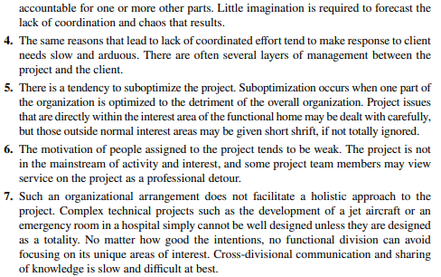
Disadvantages

Slide 12
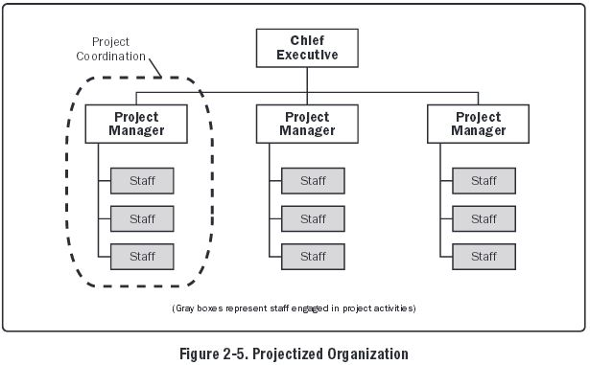
Projectized organization:

Slide 13
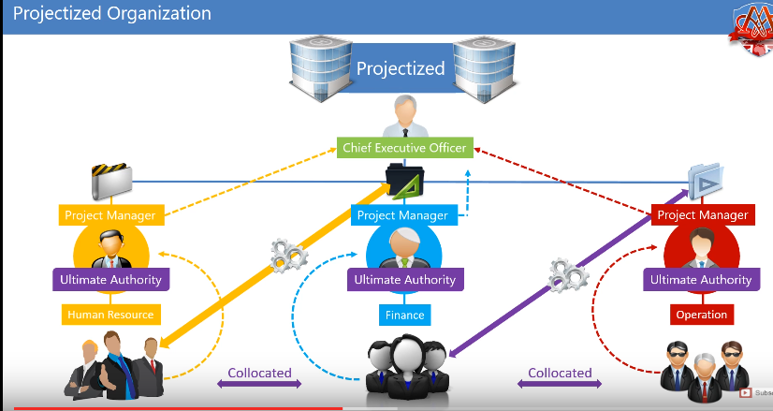

Slide 14
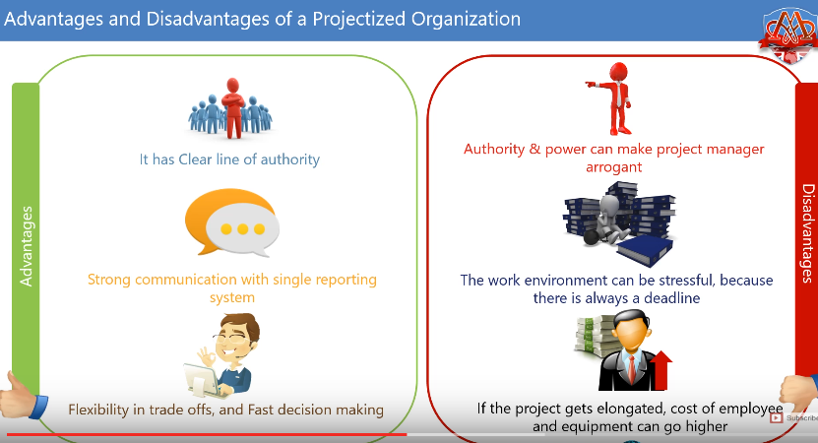

Slide 15
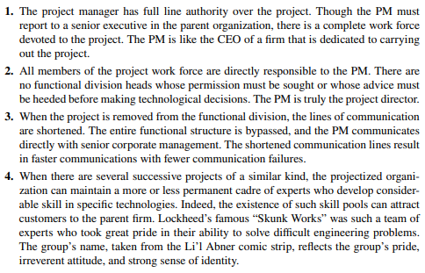
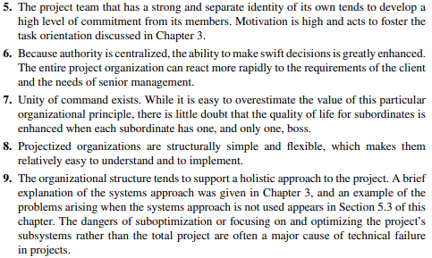
Advantages

Slide 16
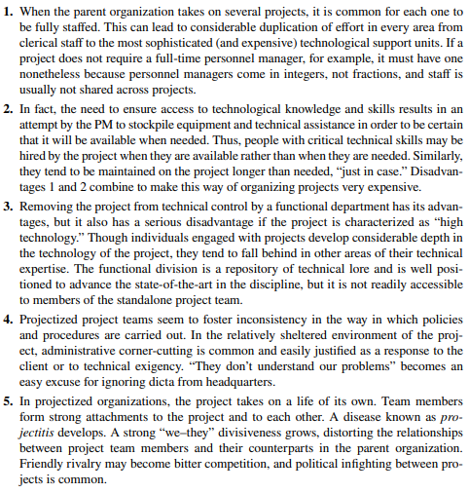

Disadvantages

Slide 17
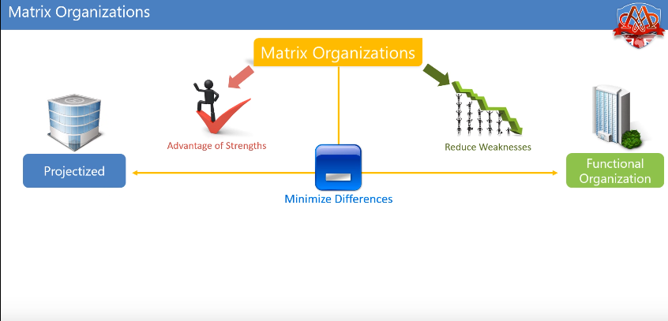

Slide 18
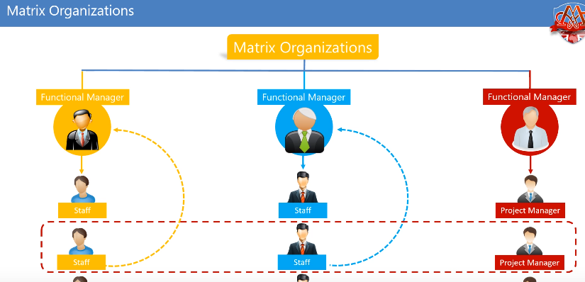

Slide 19
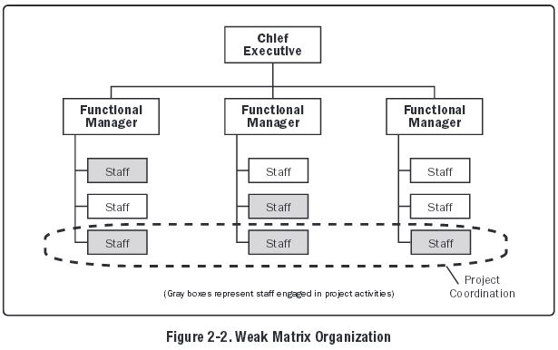
Weak matrix organizations:
similar to functional organization
project manager: functions as expeditor or coordinator
project expeditor: works as staff assistant and communications coordinator but does not make or enforce decisions
project coordinator: makes some decisions, has some authority, and reports to a higher-level manager

Slide 20
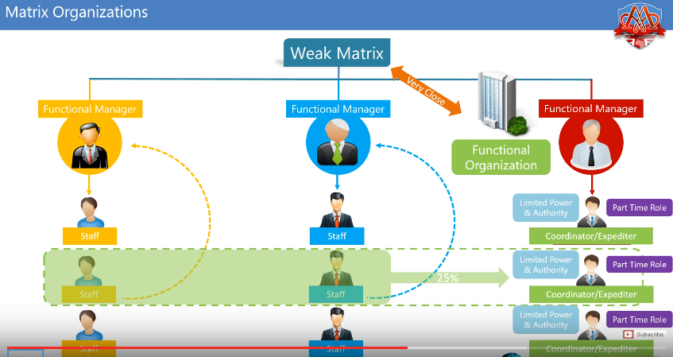

Slide 21
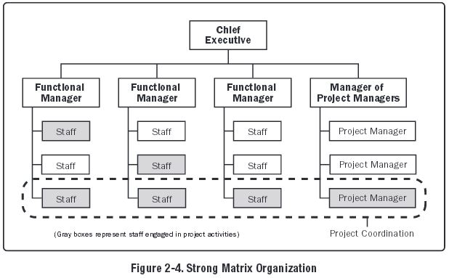
Strong matrix organizations:
similar to project organization
have full-time project managers with considerable authority
full-time project administrative staff

Slide 22
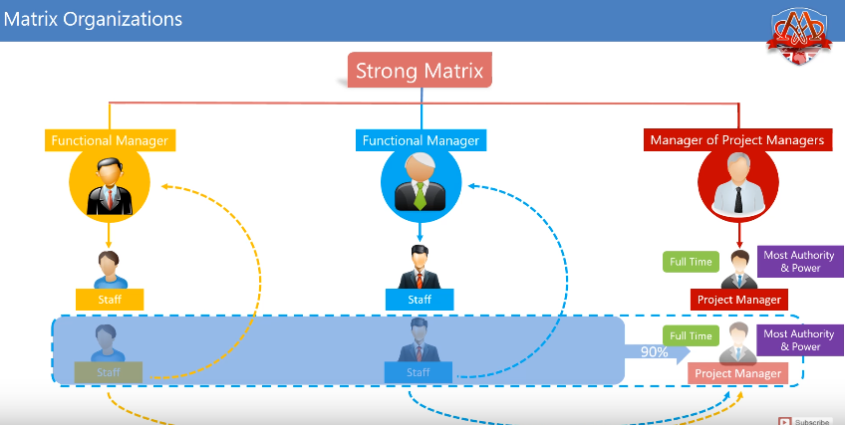

Slide 23
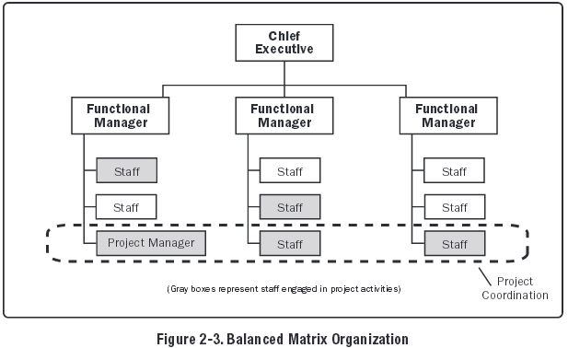
Balanced matrix organization:
recognizes the need for a project manager
neither provides the project manager with full authority over the project nor over project funding

Slide 24
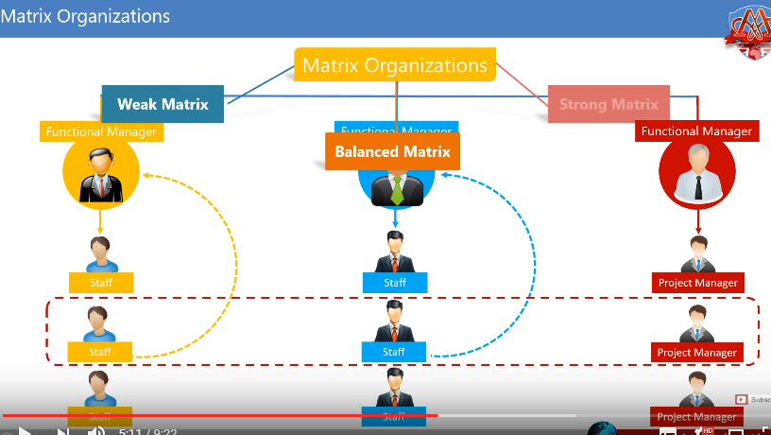

Slide 25
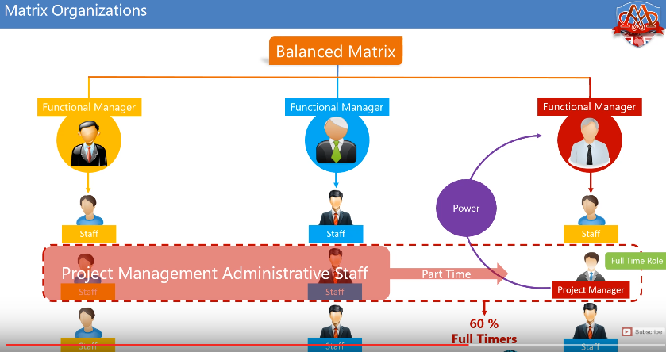

Slide 26
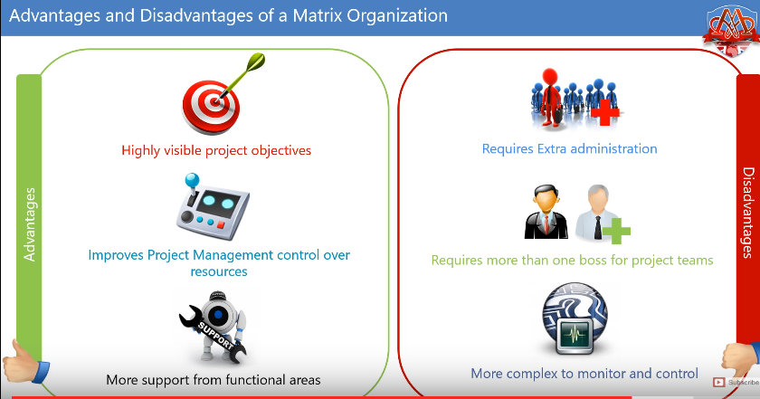

Slide 27
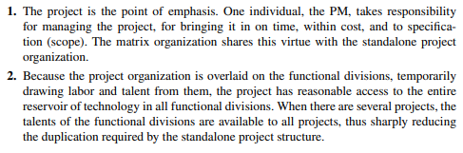
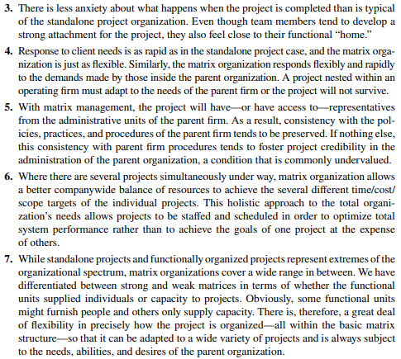
Advantages

Slide 28
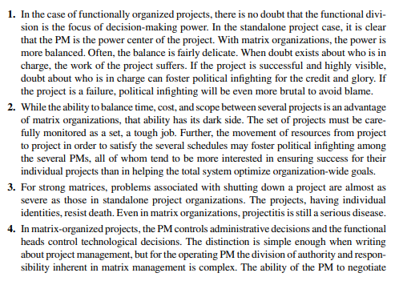
Disadvantages

Slide 29
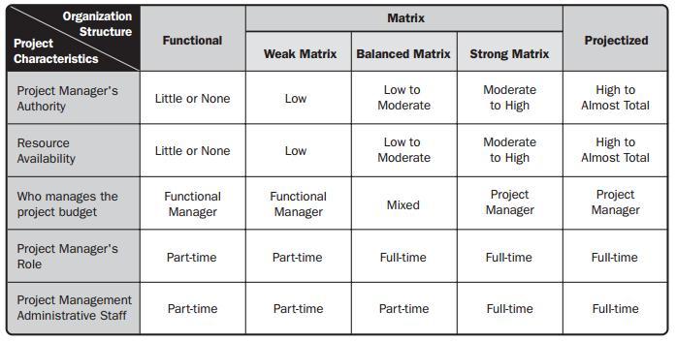

Slide 30
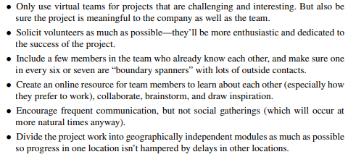
Virtual Projects
Virtual projects are those in which work on the project team crosses time, space, organizational, or cultural boundaries.
Thus, a virtual team may work in different time zones, be geographically dispersed, work in different organizations, or work in different cultures.
In all cases, the rise of virtual projects has been facilitated by the use of the Internet and other communication technologies.
Some rules for success when organizations find they must use geographically dispersed virtual teams for some of their projects

Slide 31
